Slide 1
Mastering Project Management for Admins
In time & scope - No sweat - No tears
Johann Furmann
November 21, 2019
Notes:
Hello. I´m so proud be here. Thank you very much for having me.
<waving>
Not too long ago I became an accidental Admin. I guess most of you as well.
<pause>
Often we Admins become part of Salesforce projects.
Most of these projects at some point have crunch-time and sometimes even tears.
Deadlines are missed, users are unhappy and managers are furiouse.
<pause>
But it doesn´t have to be this way.
Imagine a world where projects are delivered in time, in scope, no sweat, no tears.
We Admins can be a great asset to achieve that goal.
We can be supporting or even leading Salesforce Projects.
Today, together we will explore 6 concepts how to deliver your next project like a pro.

Slide 2



Forward Looking Statement
Statement under the Private Securities Litigation Reform Act of 1995:
This presentation contains forward-looking statements about the company’s financial and operating results, which may include expected GAAP and non-GAAP financial and other operating and non-operating results, including revenue, net income, diluted earnings per share, operating cash flow growth, operating margin improvement, expected revenue growth, expected current remaining performance obligation growth, expected tax rates, the one-time accounting non-cash charge that was incurred in connection with the Salesforce.org combination; stock-based compensation expenses, amortization of purchased intangibles, shares outstanding, market growth and sustainability goals. The achievement or success of the matters covered by such forward-looking statements involves risks, uncertainties and assumptions. If any such risks or uncertainties materialize or if any of the assumptions prove incorrect, the company’s results could differ materially from the results expressed or implied by the forward-looking statements we make.
The risks and uncertainties referred to above include -- but are not limited to -- risks associated with the effect of general economic and market conditions; the impact of geopolitical events; the impact of foreign currency exchange rate and interest rate fluctuations on our results; our business strategy and our plan to build our business, including our strategy to be the leading provider of enterprise cloud computing applications and platforms; the pace of change and innovation in enterprise cloud computing services; the seasonal nature of our sales cycles; the competitive nature of the market in which we participate; our international expansion strategy; the demands on our personnel and infrastructure resulting from significant growth in our customer base and operations, including as a result of acquisitions; our service performance and security, including the resources and costs required to avoid unanticipated downtime and prevent, detect and remediate potential security breaches; the expenses associated with new data centers and third-party infrastructure providers; additional data center capacity; real estate and office facilities space; our operating results and cash flows; new services and product features, including any efforts to expand our services beyond the CRM market; our strategy of acquiring or making investments in complementary businesses, joint ventures, services, technologies and intellectual property rights; the performance and fair value of our investments in complementary businesses through our strategic investment portfolio; our ability to realize the benefits from strategic partnerships, joint ventures and investments; the impact of future gains or losses from our strategic investment portfolio, including gains or losses from overall market conditions that may affect the publicly traded companies within the company's strategic investment portfolio; our ability to execute our business plans; our ability to successfully integrate acquired businesses and technologies, including delays related to the integration of Tableau due to regulatory review by the United Kingdom Competition and Markets Authority; our ability to continue to grow unearned revenue and remaining performance obligation; our ability to protect our intellectual property rights; our ability to develop our brands; our reliance on third-party hardware, software and platform providers; our dependency on the development and maintenance of the infrastructure of the Internet; the effect of evolving domestic and foreign government regulations, including those related to the provision of services on the Internet, those related to accessing the Internet, and those addressing data privacy, cross-border data transfers and import and export controls; the valuation of our deferred tax assets and the release of related valuation allowances; the potential availability of additional tax assets in the future; the impact of new accounting pronouncements and tax laws; uncertainties affecting our ability to estimate our tax rate; the impact of expensing stock options and other equity awards; the sufficiency of our capital resources; factors related to our outstanding debt, revolving credit facility, term loan and loan associated with 50 Fremont; compliance with our debt covenants and lease obligations; current and potential litigation involving us; and the impact of climate change.
Further information on these and other factors that could affect the company’s financial results is included in the reports on Forms 10-K, 10-Q and 8-K and in other filings it makes with the Securities and Exchange Commission from time to time. These documents are available on the SEC Filings section of the Investor Information section of the company’s website at www.salesforce.com/investor.
Salesforce.com, inc. assumes no obligation and does not intend to update these forward-looking statements, except as required by law.
Notes:
Before we get started, please note that Salesforce is a publicly traded company so please make all of your purchasing decisions based on current features and functionality.

Slide 3

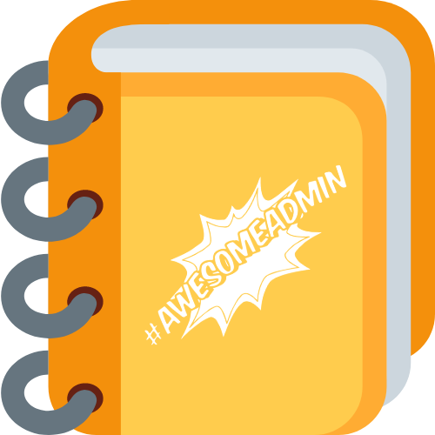


Get Your Dreamforce Admin Workbook
Ensure you make the most of DF19!
Plan your 4 perfect days
Find relevant resources
Take notes to bring back to the office
sforce.co/df19adminworkbook
Notes:
The Salesforce Admin team created a digital notebook in Quip for you to take notes in! Find it here, and you get a free personal Quip account too!

Slide 4
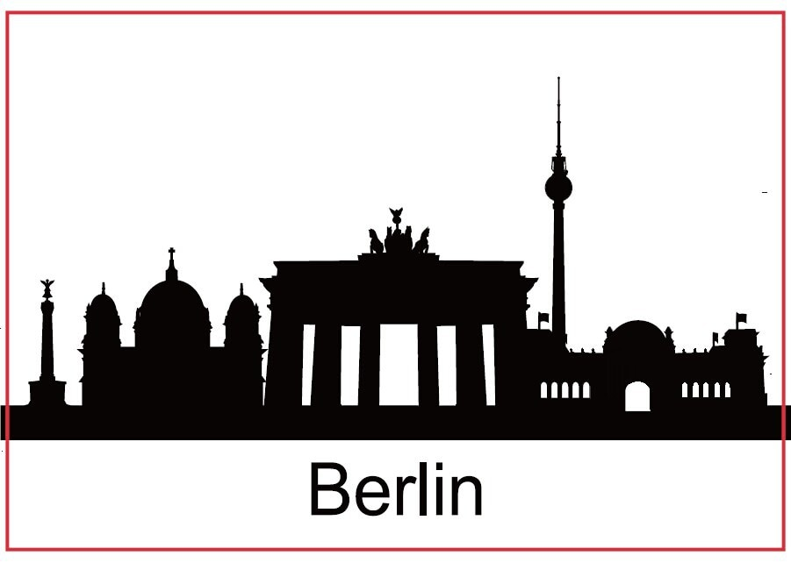
Johann Furmann
Salesforce nerd
jfuermann@gmail.com / @fliack
Notes:
A little about myself.
I´m Johann from Berlin in Germany. I spent the last 4 years in a Startup growing from 150 to about 800 Salesforce users.
Recently I started coding but my passion still lies with everything click.
And of course I´m a Trailhead addict.
But enoght about myself.
Let´s get started.

Slide 5
Where I`m coming from?
Company
800 Users
B2B2C Sales Company
7 years old Salesforce
Salesforce is at the core of the business
Lightning migration project
10 countries, 4 user groups, 4 time-zones
12 months duration
Team of 30 people
In time & scope
– No sweat –
– No tears –
Notes:
Throughout this presentation I will be using a Lightning Migration project for many examples.
But not everything I´ll talk about happened in this project. Some examples I know from friends or other Salesforce projects.
The company is a B2B2C Sales company with 800 Salesforce users. Salesforce is at the heart of the company. Almost every employee uses Salesforce all day long.
12 months ago the Lightning Migration project was started.
The project spaned across 10 countries in 4 time-zones, 800 Users and 4 distinct user groups.
On top of a technical migration we should streamline business processes.
It started stressful but once we started following some concepts it became kind of easy.
Good news, 4 weeks ago we finished.
<pause>

Slide 6

What concepts help?
In time & scope - No sweat - No tears
You have a project – acknowledge it
Focus on your primary user – no one else
Do one thing at a time – nothing else
Get something live – always
Be radical – question everything
Be different – embrace diversity
Notes:
I´ve 4 goals for a project: In time & scope. No sweat no tears.
To achieve these goals, I think there are 6 concepts which are key.
Don´t be cool, acknowledge you have a project and manage it.
Ignore managers, focus on your primary user – no one else
Harness Salesforce modularity, focus on one thing at a time and nothing else.
Get something live – always, create value fast.
Trust nobody - Be radical, question everythning.
And lastly, be different - embrace diversity.
It´s quite a wild ride for one session, let´s see if we can make it work.

Slide 7

You have a project – acknowledge it
Start planning early
Create a project team
Follow a routine
A managed project creates the
highest value.
Notes:
You have a project – acknowledge it. Why do I mention this.
I´ve got a friend, let´s call her Max.
For a few months now she has been working implementing a structured Sales process in her company.
A couple of people from different departments work on it together.
<pause>
Unfortunately, it´s not going too well. Deadlines are missed,, responsibilities are unclear. Somehow it became quite chaotic.
After quite some sweat and tears Max realized:
This is a project and somebody should manage it.
I guess, some of you where in the same situation. I definitely was quite a few times.
<pause>
There are many excuses not to have project management.
The project is too small, no need for it. We are agile, we don´t do waterfall. And my favorite one: Nobody told me to manage the project.
If you like it or not, only a managed project creates the highest value.
<pause>
It´s a Salesforce project, you are expert, it´s your system. Take control.
Step in and manage the project. Just do it.
<pause>
At the core of project management are three basic elements.
Early planning, project team and project routine.
The project plan can be very basic. At the minimum your plan must include requirements, stakeholders and a timeline.
I think it´s very important to start planning early, at least a few weeks before the project starts.
Creating a project team is another crucial step. The project team consists of a voice of the user, voice of the delivery organization and the project manager. Keep the team small, max. 8 people.
It´s very important to keep the project team cohesive and updated but at the same time not waste anybody's time. I would recommend a weekly meeting of no more than 30 minutes.
The last building block is a routine A project is chaos by definition. We want to have as much stability in it as possible. Routines create stability.
I have two routines, a daily routine and a project routine. In the morning I talk to developers, afterwards gather requirements until noon. In the afternoon write tickets. Daily wrap-up in the evening.
The whole project follows the standard IT-Project routine: Plan, build, test, release and improve.
Feel free to have any routine you like, but stick with it. Create stability.
You find more details in a resource section at the end of the slide deck. You can download from the session chatter group or my twitter feed.
These three points are all I want to talk about regarding standard project management.
From now on I will focus on concepts which are, from my point of view specific to Salesforce projects.

Slide 8
Focus on your primary user – no one else
Salesforce is user focused
Only users use your system
Management doesn´t have all information
Users know about the real processes
Listening to
primary-users
creates
the highest value.
Notes:
You started managing the project. You got a routine, you got a team and you got a plan. Now the work starts.
Thought your project you have to make thousands of decisions. Something small like the label of a button or something big like the order of project milestones.
How to decide all of this?
Traditionally: Ask managers or team-leads of the respective department you are building Salesforce for.
But let me tell you a story about some automated tasks. It was sometime last year.
The manager of the finance department gave me a nicely written list of task to be implemented. I should implement 8 automated tasks. Well done specs, criteria flashed out, subject, due date, who the task assign to. <Smile> Perfect.
By chance a team lead from this department dropped by. We started chatting. I told her about the tasks to be automated. It will great how much faster her team will be.
Well, the team-lead said, from the 8 tasks we actually don´t do 4 anymore. We changed that a few months back.
I was a little suprised, but Ok. Only 4 instead of 8 tasks to implement.
I went hard to work, implemented the 4 tasks in a Sandbox. Once done, walked over to a finance user to test the automation.
Well, the end-users from finance said, from the 4 tasks we don´t do 3 anymore. We changed that a few weeks back. And by the way, we already have a report for the remaining one.
So we are actually fine. Nothing you should change.
<pause>
The manager meant well, but her information was outdated.
The team-lead meant well, but his information was outdated.
Only the end-user had up to date information about requirements.
This is something you can learn from Salesforce. The whole system is built with the user in mind. Salesforce is not built for CEOs, it´s not built for Managers, it´s built for Sales people.
It´s fine to get ideas from Managers or Team leads. But don´t mistake their requirements for the truth. Always get your requirements directly from the End-Users.
It sounds trivial, but takes a lot of bravery. What it actually means is, don´t listen to managers
Take the time and focus on End-Users, because I can guarantee you:
Listening to End-Users creates the highest value.

Slide 9

Focus on your primary user – no one else
User Interviews
No more than 2 users at a time
Short (<15 Min.)
Average users
Build trust - no managers present
Notes:
I have two or three average users on speed dial. Getting feedback or information from them usually only takes a few minutes. Don´t make it a meeting out of it, keep it short, they have work to do. And there are no managers allowed since the users have to trust me. I want to get to the truth.
And I try to have average users, not the rock-stars of our company.
<pause>
Talking to users let´s us know what do. But how to actually get it done?

Slide 10

Do one thing at a time – and nothing else
Salesforce is modular
Don‘t multi task
Only start what you can finish
Start, finish, repeat
Only a finished task creates value.
Notes:
Do one thing at a time – and nothing else
<pause>
Through-out our days we all have countless things to do. There is a never ending string of people, ideas, bugs and other tasks.
It´s easy to get lost in a pile of half-done tasks.
This is where the stress starts.
You work and harder and still people yell at you for not delivering.
One reason are half finished tasks.
Good news, Salesforce is modular and most of your work too. It´s very much possible to break big topics into smaller tasks and finish each independently.
Don´t try to multi-task. It´s not working.
Take your to do list. Pick the task at the top and start.
While working on the first task don´t start anything else. It´s tempting to squeeze in a small request, since it´s just a couple of minutes.
No, No, no: Finish your task at hand first.
Once finished, pick the next task.
By finished I mean: You never have to touch that task again.
That sounds great in theory but in reality you often can´t finish because something is missing.
<pause>
Only start what you can finish.
<pause>
Juggling different tasks in parallel is expensive.
It costs energy to pause and resume tasks.
A half done task is basically waste.
And only once finished a task starts creating value.
Therefore: Start, finish, repeat.

Slide 11

Do one thing at a time – and nothing else
Example
Task: Optimize 100+ Page-Layouts
Prioritize: How often is it used?
Clean first layout with the help of 2 End-Users
Release cleaned layout, get feedback, finalize clean-up
Start with next layout
Notes:
At the beginning of the lightning migration project we decided to clean-up all page layouts. Quite a daunting task since we have more than 100 of them.
Most of them where a mess.
The concept „Do one thing at a time – and nothing else” helped us out a lot.
We created a list a of all page layouts, prioritized by how often are they used.
Cleaned the first layout. No management involved, just 2 users.
Released this layout, got some feedback and did some final clean-up.
And repeat.
Over the course of about 4 months we cleaned almost all page layouts one by one.
This way the cleaned layouts already created value long before official Lightning Go-Live.
Because we also followed the next concept: Get something live- always.

Slide 12
Get something live - always
Salesforce is easy to change and hard to break
Create small independent pieces
Bring each piece live as fast as possible
Silent go-live is your best friend
Only something
live provides
value.
Notes:
Usually <pause> at some point there's a big go-live at the end of a milestone or the project. Everything is brought to production in one big bang. <puff>
Ahead of Go-Live you do lot´s of testing. But , you have no idea what will happen.
The users had to wait for months for the great features.
Unfortunately some of your great features are useless, happened a few times to me.
All the features are of bugs, definitely.
So the day you worked so long for isn´t fun. The day is full with hundreds of users complaining about thousands of bugs in a borderline unusable system.
This is the dreaded first weeks of Go-Live. Most stressful time of the whole project. The days heroes are born.
Who of you was part of such a Go-Live day?
<pause>
It´s unpleasant, isn´t it?
Is there way to a way to avoid this?
Yes, you can make it a lot less painful. Get something live – always.
Salesforce is really easy to change and very hard to break.
Break your feature into very small pieces. Then you take each small piece, finish it and bring it live as fast as possible.
Maybe you remember the Page Layout Clean-up from the last concept.
But you think: The feature not ready yet, there´s so much else to do. It only has 3 out of 10 planned functions. Management hasn´t approved of it. And on top, UI is a messsy piece of shit. No way we can show that to users.
<pause>
Bring it live anyways. Get over your fear and just do it.
<pause>
You break your project into very small pieces and bring each live independently.
Since it is only a small piece you release each time, there will be only a small number of bugs. Most Salesforce Bugs are fixed fast.
And since it´s now in use by real users, you start collecting feedback.
And most important, since users are using it, might it be thaaaat tiny. It´s already creating business value.
<pause>
Ah, a small sidenote. I love, silent Go-Live. Release something and tell nobody about it.
Have it run in the Background for a week or two, check if nothing breaks. This works great for automation.
<pause>
Get over Go-Live fear, bring it live.
Because only something in live provides value.
<pause>
The last three concepts were about how to do something. The next two concepts are about mindest and attitude.

Slide 13
Be radical - question everything
Salesforce is disruptive
Trust nobody
Take risks
What really helps the business?
Radical thinking creates innovative solutions.
Notes:
Most of the requirements we get are incremental improvements.
You change what your company already does a little bit.
These are great requests, but incremental improvements can not create radical innovations.
Only radical innovations can create amazing results.
<pause>
A radical innovation doesn´t have to be about AI or even complicated. Sometimes it´s the smallest thing.
I was about to prepare the migration of Lead E-Mail templates from Classic to Lightning.
Users have been sending out about 120.000 template based E-Mails over the last years. Manually.
So users spent hundreds of hours a year sending these E-Mails. This sounds in-effective.
Asking around: Users love the Email but there´s no real way of automating. „It depends on gutt feeling“. Customers request and reply to these e-mails. Management believes in the templates and Marketing spent countless days optimizing the content.
Sounds legit. Maybe it´s just this way and the users will send out these E-Mails to leads until the end of time.
<pause>
But before I started the migrateion, I had one more simple question: Do these manual E-Mails to Leads helps us make more money?
Luckily we have a great BI team and they could provide me the numbers within a few hours.
<short pause>
But before I continue with my story. You know, who didn´t do more of the same, Salesforce. Parker Harris and Marc Benioff didn´t create an On-Premise CRM which was slightly better.
They changed the game. They questioned everything what was true in the business. Many people laughed at them and they took some risks. But you see where Salesforce is today.
But back to my E-Mail templates. BI came back with the results.
<pause>
Leads which received the template based E-Mails where slightly less likely to buy.
Sounded really strange but the numbers where clear on it. It was the opposit of what everybody told me.
<pause>
Later we actually found the reason. The manual E-Mails interfered with our automated send-outs. This was received as too much by our leads.
Anyways, It took quite some discussions, but at the end we got rid of manual Emails to leads alltogether.
Users save hundreds of working hours a year, customers are less anoyed. Who would have thought, that a simple task of migrating E-Mail templates can lead to such a radical innovation for our company.
<pause>
Just asking such radical questions is already a risk for you, implementating a even bigger one.
You will go against a lot of peoples believes.
But in order to truly master project management you have to be radical. Doing what always has been done, does not create stunning results. Only radical thinking creates innovative solutions.
<pause>

Slide 14
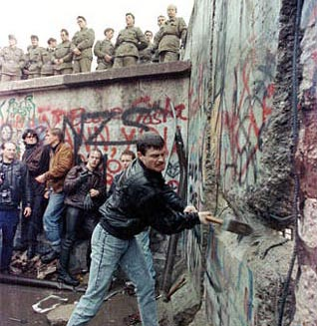
Be radical - question everything
Helpful Questions
Why do we do that?
What if we don´t do that (anymore)?
Let´s look at the numbers.
Let´s look at 10 random examples from last week.
Notes:
There´s a couple of questions which I like to ask in order to get radically better solutions.
Why do we do that?
What happens if don´t do that anymore?
Let´s look at the numbers.
Let´s look at 10 random examples from last week.
<pause>
30 years ago the people in Berlin asked: Do we relally need that Wall?
The next concept is still as radical as the fall of the Berlin wall.

Slide 15

Be different – embrace diversity
Salesforce is diversity
Create a diverse project team
Embrace your own diversity
Diversity creates
stunning results.
Notes:
De different – embrace diversity.
<pause>
Salesforce is completely different than the rest of the It industry: Salesforce is diversity
Look left and right. There´s women, there´s people of color and there´s at least one queer person in the room.
This diversity is what makes the Salesforce Ohana so great for me.
But the reality in your job might be quite different.
Tuesday morning, you are invited by management to discuss the next steps in your project. Mostly white cis men are in the room.
This is not good.
<pause>
In order to have a well rounded project you need diversity.
<pause>
You can not change your company in one big sweep. But you can use the influence you have. As a project manager you can change it a little.
Create diversity yourself, include people you think help your project be more diverse.
There might be some growling, there might be some complaints. But the results will prove your right.
<pause>
And don´t forget about yourself, embrace who you are.
In our current state of the society and industry it still takes a lot of bravery to embrace your own diversity. You will probably get some backlash.
But after all, you can always come to the Salesforce Ohana and be who you are!
<pause>

Slide 16
Wrap-up
In time & scope - No sweat - No tears
You have a project – acknowledge it
Focus on your primary user – no one else
Do one thing at a time – nothing else
Get something live – always
Be radical – question everything
Be different – embrace diversity
Notes:
<puhh> <exhale>
What a ride. 6 concepts, 25 minutes.
<exhale>
It was quite a lot. At least for me.
One more time:
Acknowlege you have a project
Focus on your primary users – no one else <pause> ignore managers
Do one thing at a time – nothing else
Get something live fast - always
Be radical - question everything
Be different – embrace diversity
In the remaining time I want help you get started once you are back in the office next week.

Slide 17


What´s next?
Use your daily work as practice
Study project management
Learn and copy from others
Trailhead Modules
Business Value of Equality
Salesforce Agile Basics
Notes:
You can start exercising. Yes, I know, exercising- buhhh.
Anyways. Treat every task you get as a small project. Yes, it´s a make-believe project but it gives you a way to practice.
These pretend projects give you also the opportunity to start creating your own project management templates.
And of course there´s lot of great content about project management online. Go ahead and do some trainings. Prince2 is something I like.
And lastly, learn and copy from project managers around you. A big thanks here to my first project management mentor, Christian Leffin, to this day I follow his advice and use his templates.
There´s two trailheads I´d like to recommend. Business Value of Equality and Salesforce Agile Basics.
<pause>

Slide 18
Additional Resources
My PM Template
User Interviews: How, When, and Why to Conduct Them
Why Multitasking Doesn't Work
How to Structure Your Day to Be More Productive
Prince2 Project Management
7 Roles in Prince2 Projects
Application Livecycle Management
The 7 Habits Of Highly Effective People
Notes:
Here´s a collection of helpful resources you can have a look yourself.
I´ll share the presentation afterwards in the session chatter, on LinkedIn and Twitter. You can half a look yourself.

Slide 19
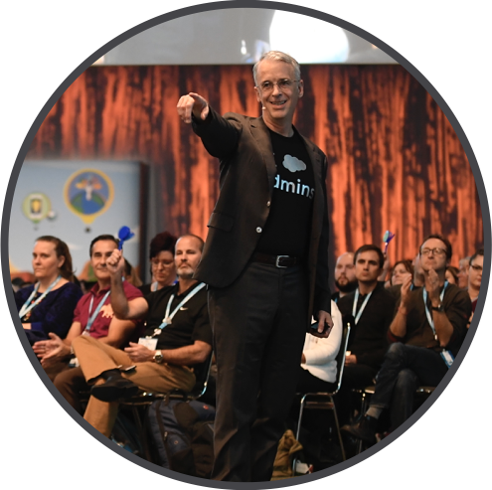
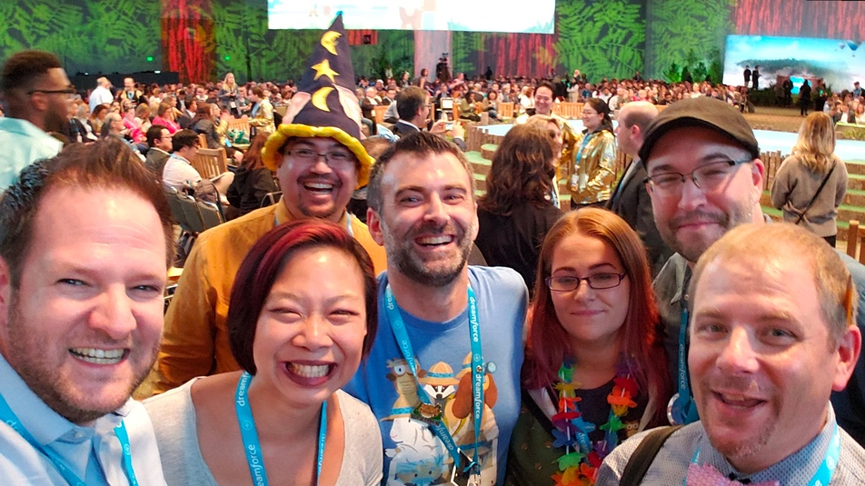
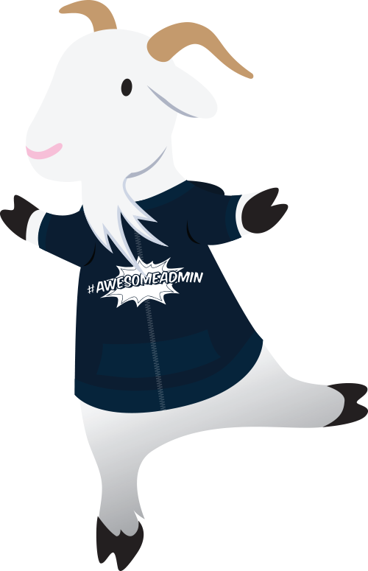
Calling all Salesforce Admins!
ADMIN KEYNOTE
Don’t miss the main event for Admins at Dreamforce!
Thursday, November 21 @ 5pm Moscone North, Hall F
Notes:
Come to the Admin Keynote! Thursday at 5PM, Moscone North, Hall F

Slide 20
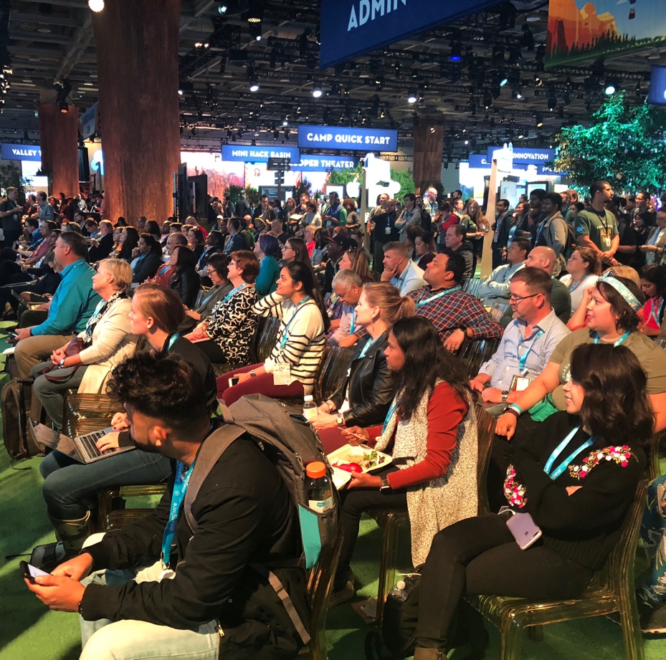
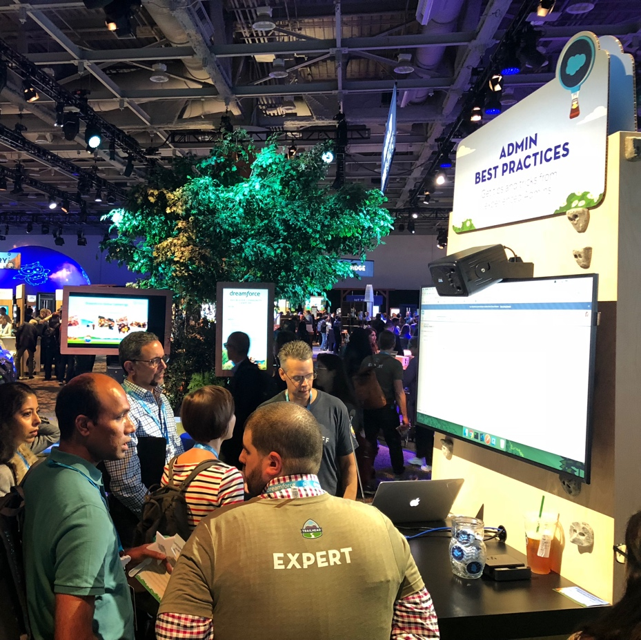
Join us in the Admin Meadow
Trailhead Zone at Moscone West, First Floor
Admin Theater
Stop by the theater to hear presentations
for Admins by Admins.
#AwesomeAdmin
Connect with fellow Admins by sharing what makes you an Admin in the meadow and online!
Admin Booths
Get your questions answered at one of the demo booths or the consultation station.
Notes:
Join us at the Admin Meadow, Moscone West First Floow in the Trailhead Zone

Slide 21
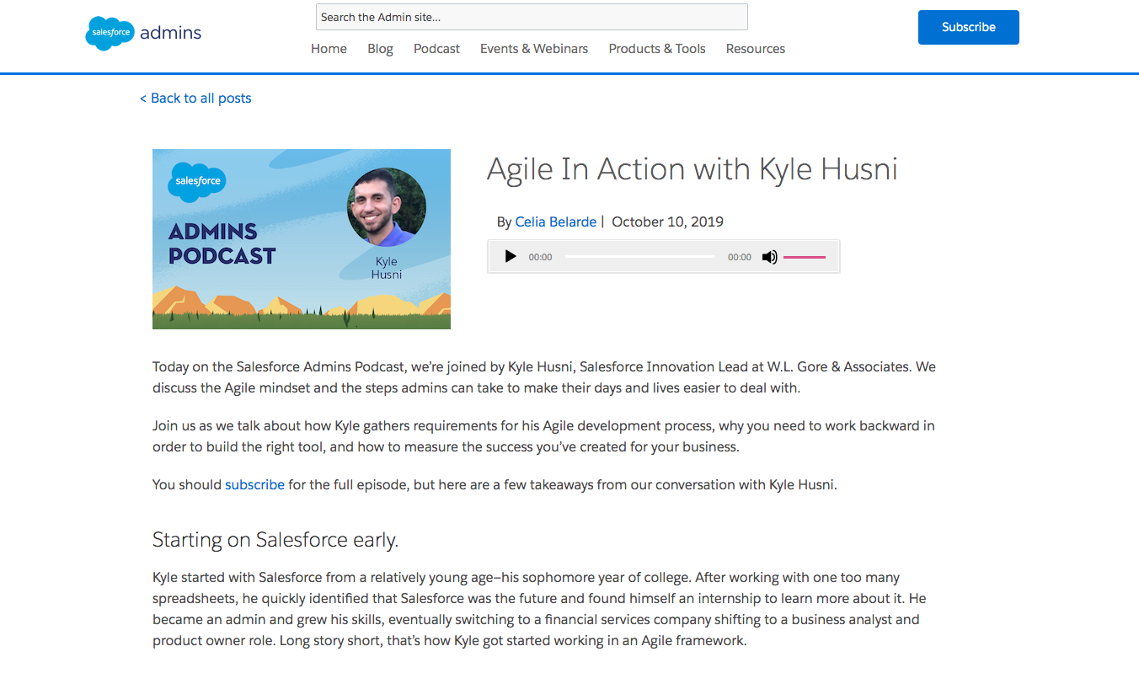
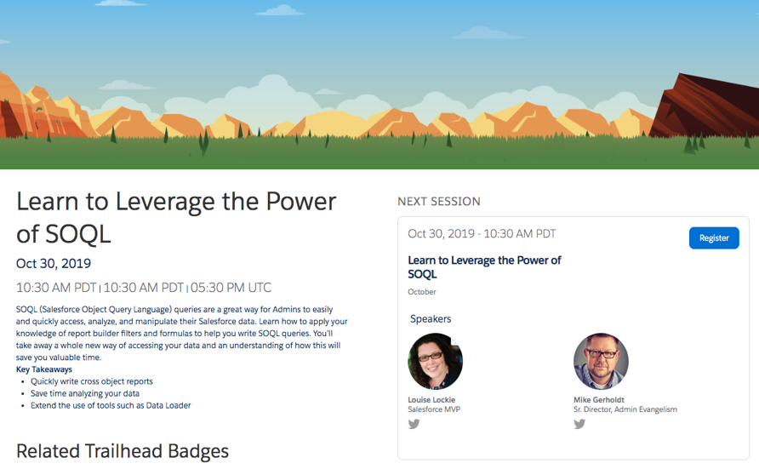
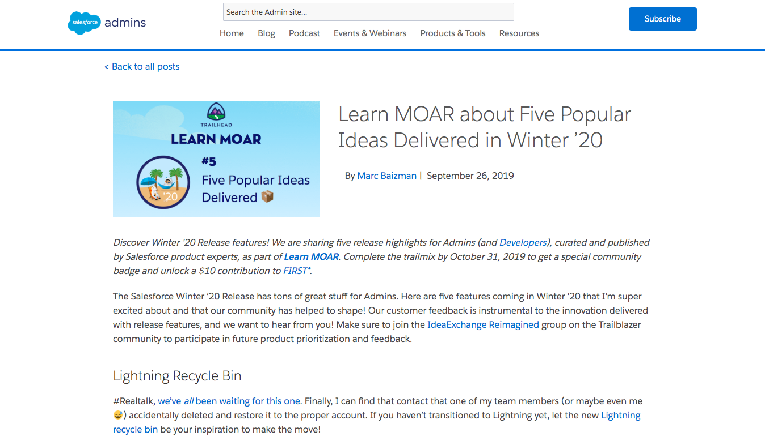
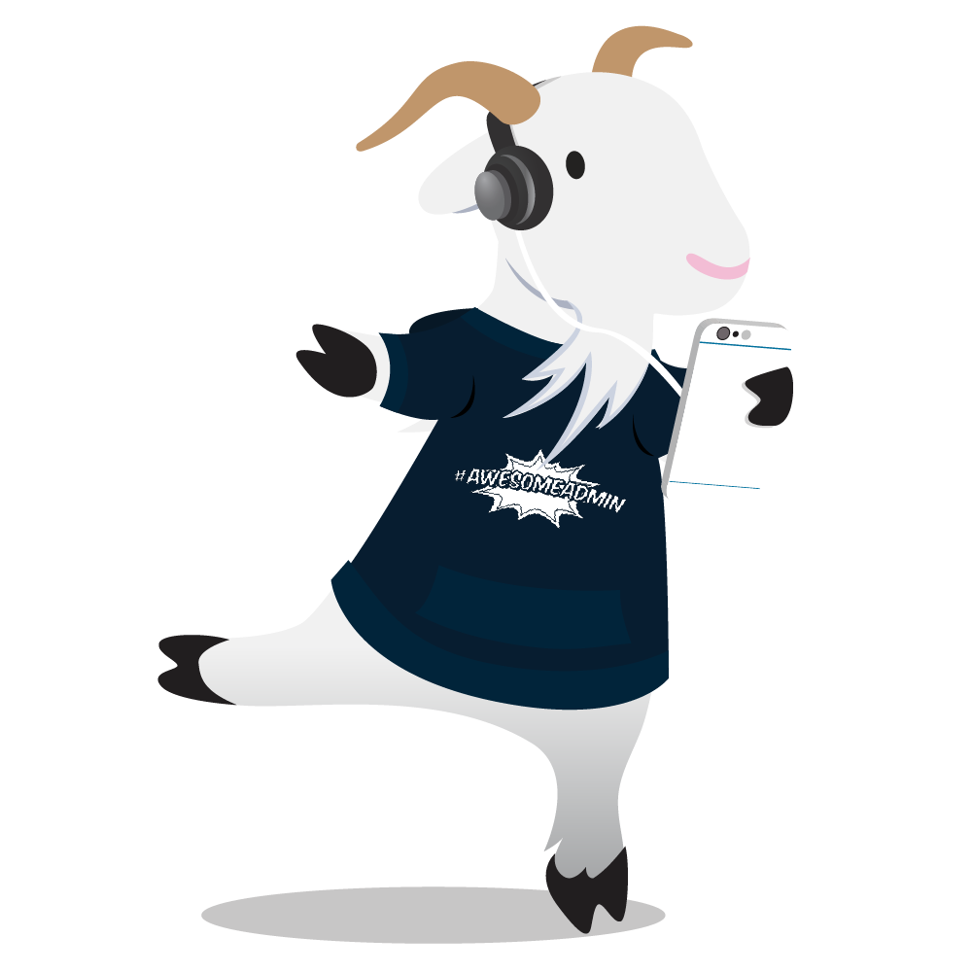





Learn From #AwesomeAdmins Online
admin.salesforce.com
Podcast
Video
Blog
connect with us
Subscribe to the Admin Digest
bit.ly/AdminDigest
Join the Conversation
@SalesforceAdmns
#AwesomeAdmin
Notes:
Check out all the great resources for AwesomeAdmins at admin.salesforce.com.

Slide 22
Notes:
This is my first Dreamforce and I´m excited to be hear with all of you. Thanks a lot for the great time!
I hope you get some inspirations how to master project management.
<pause for applause>
Questions:

Slide 23
Questions and Ideas
In time & scope - No sweat - No tears
You have a project – acknowledge it
Focus on your primary user – no one else
Do one thing at a time – nothing else
Get something live – always
Be radical – question everything
Be different – embrace diversity
Presentation and my PM template: https://bit.ly/33wH2GZ
Twitter: @fliack
Notes:
And now it´s on you.
I´m curios to hear your questions and ideas.
Questions:

